Slide 1
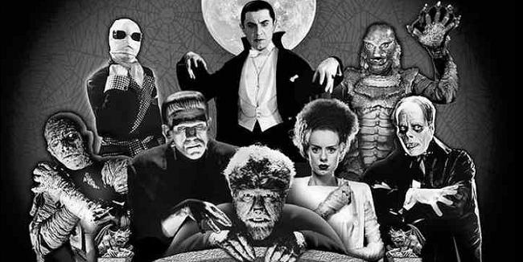
Monsters at the Margins: The Mid-Term Project

Slide 2
General Description
Choose one monster not on our syllabus
Learn everything you can about it
Develop an “angle” or focus for the project
Design the project as a team
Create a presentation using research, writing, art/design, and performance elements
Present it to the class

Slide 3


Individual Roles
The Researcher
Locates sources
Reads/learns/studies
Guides monster selection, focus
Prioritizes information
Shares sources/information with group
Documents all sources

Slide 4


Individual Roles
The Writer
Creates original language
Helps prioritize information
Uses language to teach/explain/entertain
Edits and proofreads all text
Helps document all sources

Slide 5
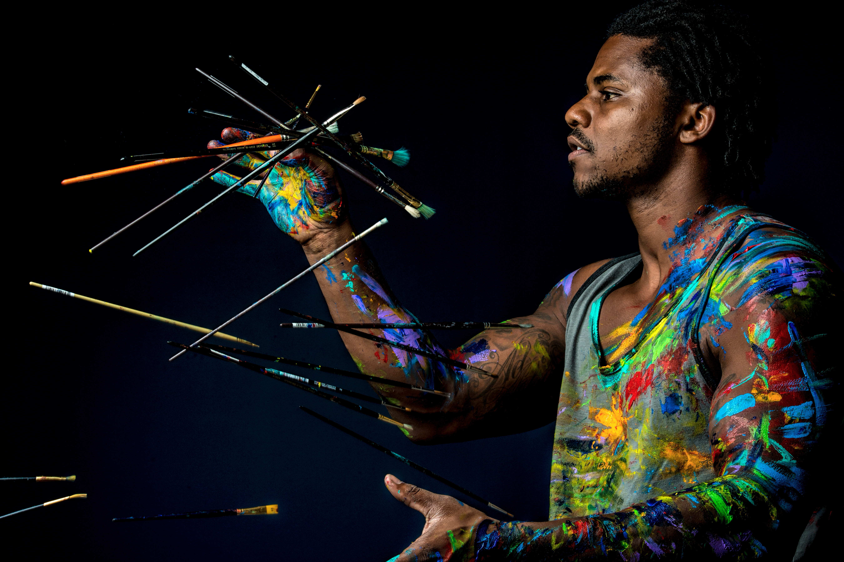

Individual Roles
The Artist/Designer
Creates original artwork
Uses images, film, music, etc.
Designs slide-cast presentation (e.g., PowerPoint, Keynote)
Presents information visually/creatively/effectively
Cites all A/V material

Slide 6


Individual Roles
The Presenter
Becomes an expert on all knowledge presented
Uses public speaking skills to teach and entertain audience
Contributes further knowledge
Adds dramatic/performative elements to the presentation
Responds 1st to audience Qs

Slide 7
Shared Responsibilities
All Group Members
Study and learn about the subject
Make decisions about the project, especially:
Which information should be presented
How all material should be presented
Whether the final product measures up
Actively contribute to the project
Are responsible for answering questions after the presentation

Slide 8
Role Selection
1. Role Selection via Google Doc is due by Monday, Jan 15 at 12pm/noon.
*If signing up for Artist/Designer, please note which term best describes you
2. I will assign groups before class on Tues, Jan 16.
3. You will meet for 30 min. in class on Tues, Jan 16 to discuss:
Monster selection
Role delegation
Task delegation

Slide 9

Future Deadlines
Fri, Jan. 19: Monster selection email due
Fri, Feb. 2: Project Proposal due
Tues/Thurs, Mar. 16/18: Group Presentations
Group and Self Evaluations due day after presenting

Slide 10
Possible "To Do" List
DETERMINE CREATIVE ASPECTS
WORK ON CREATIVE ASPECTS
WRITE COPY (SLIDES, CREATIVE ASPECTS, PRESENTATION)
CREATE SLIDES
*CREATE/REFINE THESIS
*CREATE/REFINE CONNECTION TO COURSE CONCEPT(S)
*CREATE/REFINE CONNECTION TO CULTURAL ISSUE
DECIDE WHAT ‘FOUND’ MEDIA WILL BE USED (IF ANY)
FIND INTERESTING/AMUSING ANECDOTES, INFO, ETC.
DELEGATE TASKS FOR ANY OF THE ABOVE
CREATE A SCHEDULE FOR COMPLETION OF TASKS
SCHEDULE A PRACTICE SESSION
PRACTICE

Slide 11
Group Project Checklist

